Slide 1

人工智能实践
Artificial Intelligence Practice
DCS3015 Autumn 2022
Chao Yu （余超）
School of Computer Science and Engineering
Sun Yat-Sen University

Slide 2
Lecture 4：机器学习-1
课件来源：by E. Alpaydin、Geoffrey Hinton、Ray Mooney、李宏毅等

Slide 3
What is Machine Learning?
“Learning is any process by which a system improves performance from experience.”
- Herbert Simon
Definition by Tom Mitchell (1998):
Machine Learning is the study of algorithms that
improve their performance P
at some task T
with experience E.
A well-defined learning task is given by <P, T, E>.

Slide 4
Defining the Learning Task
Improve on task T, with respect to performance metric P, based on experience E
T: Playing checkers
P: Percentage of games won against an arbitrary opponent E: Playing practice games against itself
T: Recognizing hand-written words
P: Percentage of words correctly classified
E: Database of human-labeled images of handwritten words
T: Driving on four-lane highways using vision sensors
P: Average distance traveled before a human-judged error
E: A sequence of images and steering commands recorded while observing a human driver.
T: Categorize email messages as spam or legitimate. P: Percentage of email messages correctly classified. E: Database of emails, some with human-given labels
Slide credit: Ray Mooney

Slide 5
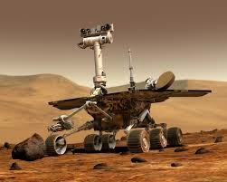
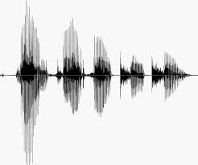
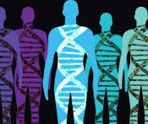
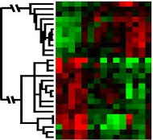
When Do We Use Machine Learning?
ML is used when:
Human expertise does not exist (navigating on Mars)
Humans can’t explain their expertise (speech recognition)
Models must be customized (personalized medicine)
Models are based on huge amounts of data (genomics)
Learning isn’t always useful:
There is no need to “learn” to calculate payroll
Based on slide by E. Alpaydin

Slide 6
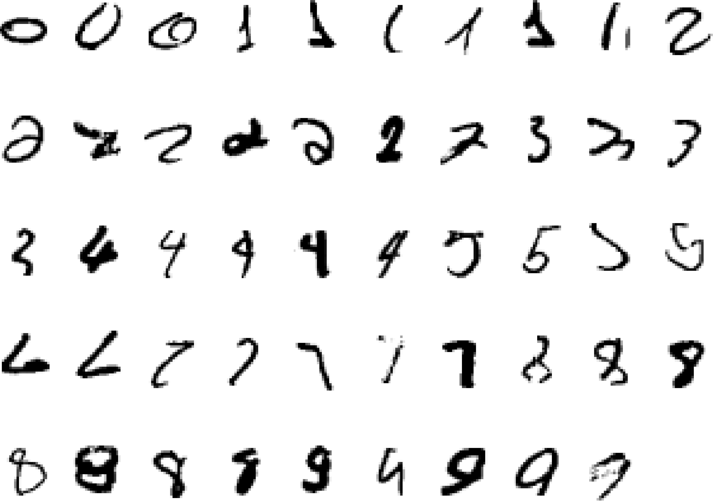
A classic example that requires machine learning:
It is very hard to say what makes a 2
Slide credit: Geoffrey Hinton

Slide 7
Some more examples that are best solved by using a learning algorithm
Recognizing patterns:
Facial identities or facial expressions
Handwritten or spoken words
Medical images
Generating patterns:
Generating images or motion sequences
Recognizing anomalies:
Unusual credit card transactions
Unusual patterns of sensor readings in a nuclear power plant
Prediction:
Future stock prices or currency exchange rates
Slide credit: Geoffrey Hinton

Slide 8
Sample Applications
Web search
Computational biology
Finance
E-commerce
Space exploration
Robotics
Information extraction
Social networks
Debugging software
[Your favorite area]
Slide credit: Pedro Domingos

Slide 9
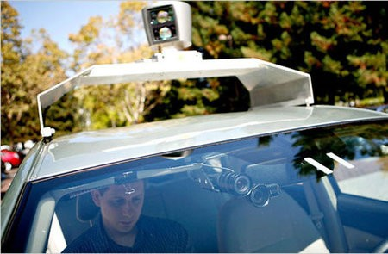
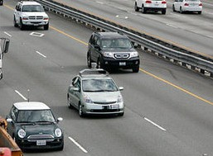
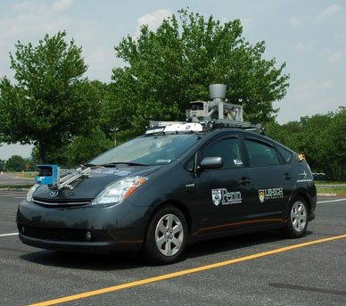
Autonomous Cars
Nevada made it legal for autonomous cars to drive on roads in June 2011
As of 2013, four states (Nevada, Florida, California, and Michigan) have legalized autonomous cars
Penn’s Autonomous Car →
(Ben Franklin Racing Team)

Slide 10
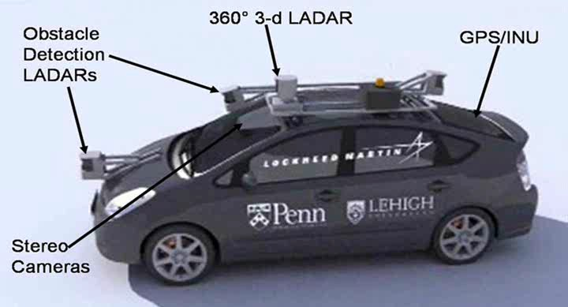
Autonomous Car Sensors
13

Slide 11
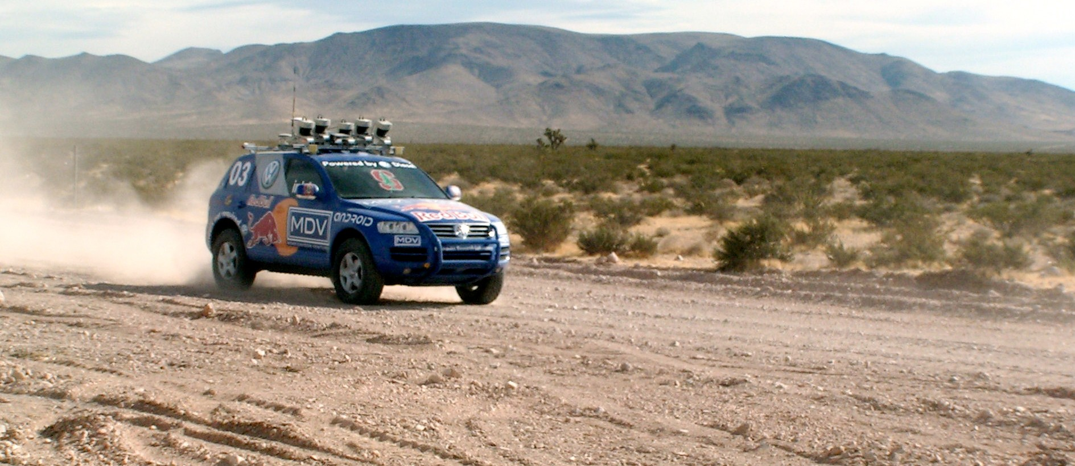
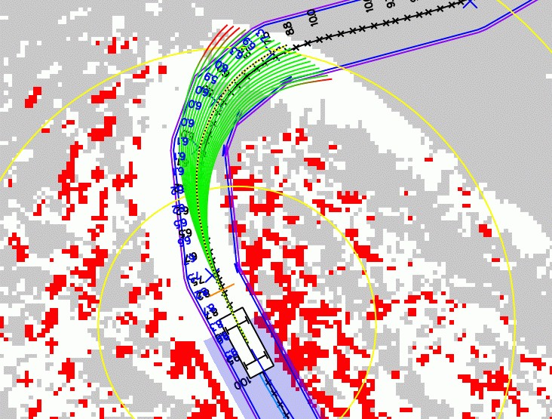
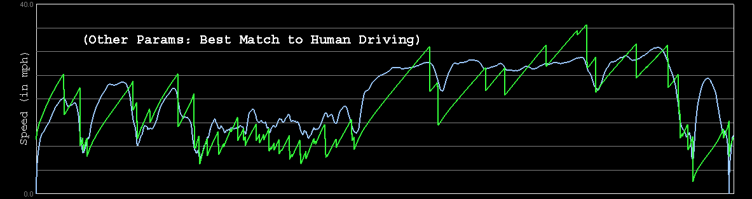
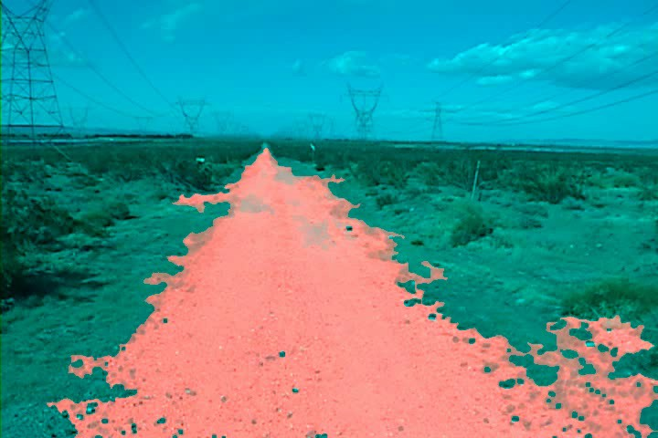
Autonomous Car Technology
Path Planning
Laser Terrain Mapping
Learning from Human Drivers
Sebastian
Adaptive Vision
Stanley
Images and movies taken from Sebastian Thrun’s multimedia w¹e⁴bsite.

Slide 12
History of Machine Learning
1950s
Samuel’s checker player
Selfridge’s Pandemonium
1960s:
Neural networks: Perceptron
Pattern recognition
Learning in the limit theory
Minsky and Papert prove limitations of Perceptron
1970s:
Symbolic concept induction
Winston’s arch learner
Expert systems and the knowledge acquisition bottleneck
Quinlan’s ID3
Michalski’s AQ and soybean diagnosis
Scientific discovery with BACON
Mathematical discovery with AM
Slide credit: Ray Mooney

Slide 13
History of Machine Learning (cont.)
1980s:
Advanced decision tree and rule learning
Explanation-based Learning (EBL)
Learning and planning and problem solving
Utility problem
Analogy
Cognitive architectures
Resurgence of neural networks (connectionism, backpropagation)
Valiant’s PAC Learning Theory
Focus on experimental methodology
1990s
Data mining
Adaptive software agents and web applications
Text learning
Reinforcement learning (RL)
Inductive Logic Programming (ILP)
Ensembles: Bagging, Boosting, and Stacking
Bayes Net learning
Slide credit: Ray Mooney

Slide 14
History of Machine Learning (cont.)
2000s
Support vector machines & kernel methods
Graphical models
Statistical relational learning
Transfer learning
Sequence labeling
Collective classification and structured outputs
Computer Systems Applications (Compilers, Debugging, Graphics, Security)
E-mail management
Personalized assistants that learn
Learning in robotics and vision
2010s
Deep learning systems
Learning for big data
Bayesian methods
Multi-task & lifelong learning
Applications to vision, speech, social networks, learning to read, etc.
– ???
Based on slide by Ray Mooney

Slide 15
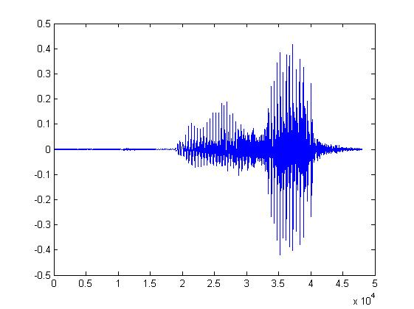
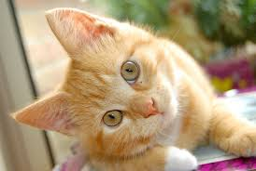
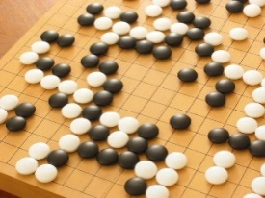
Machine Learning ≈ Looking for Function
“How are you”
“Cat”
“5-5”
(next move)

Slide 16
Types of Learning
Supervised (inductive) learning
Given: training data + desired outputs (labels)
Unsupervised learning
Given: training data (without desired outputs)
Semi-supervised learning
Given: training data + a few desired outputs
Reinforcement learning
Rewards from sequence of actions
Based on slide by Pedro Domingos

Slide 17






Designing a Learning System
Choose the training experience
Choose exactly what is to be learned
– i.e. the target function
Choose how to represent the target function
Choose a learning algorithm to infer the target function from the experience
Training data
Learner
Environment/ Experience
Knowledge
Testing data
Performance Element
Based on slide by Ray Mooney

Slide 18
Training vs. Test Distribution
We generally assume that the training and test examples are independently drawn from the same overall distribution of data
– We call this “i.i.d” which stands for “independent and identically distributed”
If examples are not independent, requires
collective classification
If test distribution is different, requires
transfer learning
Slide credit: Ray Mooney

Slide 19
ML in a Nutshell
Tens of thousands of machine learning algorithms
Hundreds new every year
Every ML algorithm has three components:
Representation（Model）
Optimization
Evaluation
Slide credit: Pedro Domingos

Slide 20
Various Function Representations
Numerical functions
Linear regression
Neural networks
Support vector machines
Symbolic functions
Decision trees
Rules in propositional logic
Rules in first-order predicate logic
Instance-based functions
Nearest-neighbor
Case-based
Probabilistic Graphical Models
Naïve Bayes
Bayesian networks
Hidden-Markov Models (HMMs)
Probabilistic Context Free Grammars (PCFGs)
Markov networks
Slide credit: Ray Mooney

Slide 21
Various Search/Optimization Algorithms
Gradient descent
Perceptron
Backpropagation
Dynamic Programming
HMM Learning
PCFG Learning
Divide and Conquer
Decision tree induction
Rule learning
Evolutionary Computation
Genetic Algorithms (GAs)
Genetic Programming (GP)
Neuro-evolution
Slide credit: Ray Mooney

Slide 22
Evaluation
Accuracy
Precision and recall
Squared error
Likelihood
Posterior probability
Cost / Utility
Margin
Entropy
K-L divergence
etc.
Slide credit: Pedro Domingos

Slide 23


ML in Practice
Understand domain, prior knowledge, and goals
Data integration, selection, cleaning, pre-processing, etc.
Learn models
Interpret results
Consolidate and deploy discovered knowledge
Loop
Based on a slide by Pedro Domingos

Slide 24
Lessons Learned about Learning
Learning can be viewed as using direct or indirect experience to approximate a chosen target function.
Function approximation can be viewed as a search through a space of hypotheses (representations of functions) for one that best fits a set of training data.
Different learning methods assume different hypothesis spaces (representation languages) and/or employ different search techniques.
Based on a slide by Pedro Domingos
Slide credit: Ray Mooney

Slide 25



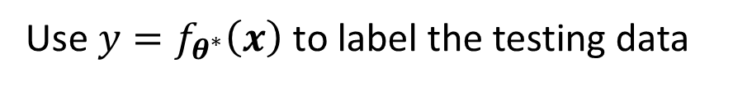



Framework of ML
Step 1: function with unknown
Step 2: define loss from training data
Step 3: optimization
Training data:
$$\left\{\left(x^{1},{\hat{y}}^{1}\right),\left(x^{2},{\hat{y}}^{2}\right),…,\left(x^{N},{\hat{y}}^{N}\right)\right\}$$
Training:
$$y=f_{θ}\left(x\right)$$
$$L\left(θ\right)$$
$$θ^{∗}=arg\min_{θ}{L}$$
Testing data:
$$\left\{x^{N+1},x^{N+2},…,x^{N+M}\right\}$$
Use $y=f_{θ^{∗}}\left(x\right)$ to label the testing data
$$\left\{y^{N+1},y^{N+2},…,y^{N+M}\right\}$$

Slide 26

Framework of ML
General Guide
loss on training data
large
small
model
bias
loss on testing data
optimization
large
small
make your model complex
More powerful optimization technology
overfitting
mismatch
trade-off
more training data
Transfer learning
data augmentation
make your model simpler

Slide 27

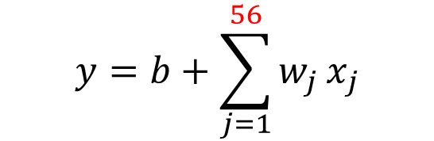


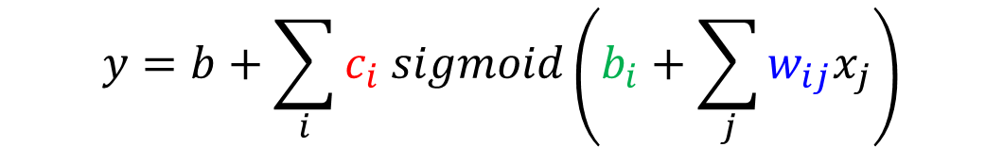



Framework of ML —— Model Bias
Model Bias
$$y=f_{θ}\left(x\right)$$
$$f_{θ^{1}}\left(x\right)$$
The model is too simple
$$f_{θ^{2}}\left(x\right)$$
find a needle in a haystack …
$$f_{θ^{∗}}\left(x\right)$$
… but there is no needle
too small …
$$f^{∗}\left(x\right)$$
small loss
Solution: redesign your model to make it more flexible
More features
$$y=b+\sum_{j=1}^{56}{w_{j}}x_{j}$$
$$y=b+wx_{1}$$
Deep Learning
(more neurons, layers)
$$y=b+\sum_{i}{c_{i} sigmoid\left(b_{i}+\sum_{j}{w_{ij}x_{j}}\right)}$$

Slide 28
Framework of ML
General Guide
loss on training data
large
small
model
bias
loss on testing data
optimization
large
small
make your model complex
More powerful optimization technology
overfitting
mismatch
trade-off
more training data
Transfer learning
data augmentation
make your model simpler

Slide 29









Framework of ML —— Optimization
Optimization Issue
Large loss not always imply model bias. There is another possibility …
$$f_{θ^{2}}\left(x\right)$$
$$f_{θ^{∗}}\left(x\right)$$
$$f_{θ^{1}}\left(x\right)$$
$$L$$
$$y=f_{θ}\left(x\right)$$
$$L\left(θ^{∗}\right)$$
large
$$f^{∗}\left(x\right)$$
$$θ$$
A needle is in a haystack …
$$θ^{∗}$$
… Just cannot find it.

Slide 30









Framework of ML —— Optimization
$$f_{θ^{1}}\left(x\right)$$
Model Bias
$$f_{θ^{2}}\left(x\right)$$
find a needle in a haystack …
$$f_{θ^{∗}}\left(x\right)$$
… but there is no needle
too small …
$$f^{∗}\left(x\right)$$
small loss
Which one???
$$f_{θ^{2}}\left(x\right)$$
$$f_{θ^{∗}}\left(x\right)$$
Optimization Issue
$$f_{θ^{1}}\left(x\right)$$
A needle is in a haystack …
$$y=f_{θ}\left(x\right)$$
… Just cannot find it.
$$f^{∗}\left(x\right)$$

Slide 31
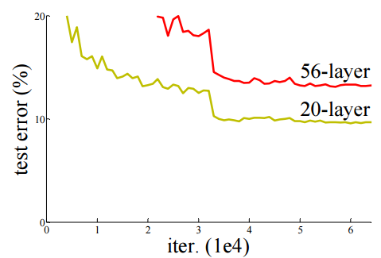
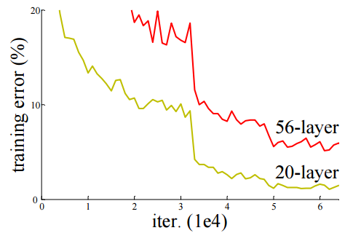

Framework of ML —— Optimization
Model Bias v.s. Optimization Issue
Gaining the insights from comparison
Optimization issue
Overfitting?
Testing Data
Training Data
Ref: http://arxiv.org/abs/1512.03385

Slide 32
Framework of ML —— Optimization
Optimization Issue
Gaining the insights from comparison
Start from shallower networks (or other models), which are easier to optimize.
If deeper networks do not obtain smaller loss on training data, then there is optimization issue.
Solution: More powerful optimization technology
 | 1 layer | 2 layer | 3 layer | 4 layer | 5 layer
2017 – 2020 | 0.28k | 0.18k | 0.14k | 0.10k | 0.34k

Slide 33
Framework of ML
General Guide
loss on training data
large
small
model
bias
loss on testing data
optimization
large
small
make your model complex
More powerful optimization technology
overfitting
mismatch
trade-off
more training data
Transfer learning
data augmentation
make your model simpler

Slide 34
Framework of ML
General Guide
loss on training data
large
small
model
bias
loss on testing data
optimization
large
small
make your model complex
More powerful optimization technology
overfitting
mismatch
trade-off
more training data
Transfer learning
data augmentation
make your model simpler

Slide 35




Framework of ML —— Overfitting
Small loss on training data, large loss on testing data. Why?
An extreme example
Training data:
$$\left\{\left(x^{1},{\hat{y}}^{1}\right),\left(x^{2},{\hat{y}}^{2}\right),…,\left(x^{N},{\hat{y}}^{N}\right)\right\}$$
$$f\left(x\right)=\left\{\begin{aligned}{\hat{y}}^{i} \\ random\end{aligned}\right.$$
$$∃x^{i}=x$$
Less than useless …
$$otherwise$$
This function obtains zero training loss, but large testing loss.

Slide 36






Framework of ML —— Overfitting
$$y$$
“freestyle”
$$y$$
Flexible model
$$x$$
$$x$$
$$y$$
Large loss
Real data distribution (not observable)
Training data
Testing data
$$x$$

Slide 37
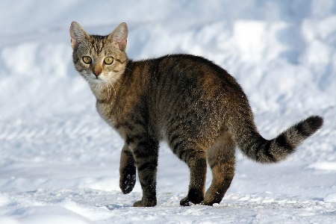
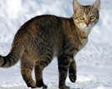
Framework of ML —— Overfitting
$$y$$
$$y$$
Flexible model
$$x$$
More training data
$$x$$
Data augmentation

Slide 38

Framework of ML —— Overfitting
$$y$$
$$y=a+bx+cx^{2}$$
$$y$$
constrained
model
$$x$$
$$x$$
Real data distribution (not observable)
Training data
Testing data

Slide 39
Framework of ML —— Overfitting
$$y$$
$$y=a+bx+cx^{2}$$
$$y$$
constrained
model
$$x$$
$$x$$
$$y$$
Real data distribution (not observable)
Training data
Testing data
$$x$$

Slide 40
Framework of ML —— Overfitting
$$y$$
$$y=a+bx+cx^{2}$$
$$y$$
constrained
model
$$x$$
$$x$$
Less parameters, sharing parameters
Less features
Early stopping
Regularization
Dropout
Fully-connected
CNN

Slide 41

Framework of ML —— Overfitting
$$y$$
$$y=a+bx$$
$$y$$
constrain too much
$$x$$
$$x$$
$$y$$
Back to model bias …
Real data distribution (not observable)
Training data
Testing data
$$x$$

Slide 42
Framework of ML —— Overfitting
Bias-Complexity Trade-off
loss
Testing loss
select this one
Training loss
Model becomes complex
(e.g. more features, more parameters)

Slide 43
Framework of ML —— Overfitting
Cross Validation
How to split?
public
private
Training Set
Testing Set
Testing Set
Training Set
Validation
set
Using the results of public testing data to select your model
You are making public set better than private set.
Model 1
mse = 0.9
Model 2
mse = 0.7
Not recommend
Model 3
mse = 0.5
mse > 0.5
mse > 0.5

Slide 44
Framework of ML —— Overfitting
N-fold Cross Validation
Training Set
Model 1
Model 2
Model 3
Train
Train
Val
mse = 0.2
mse = 0.4
mse = 0.4
Train
Val
Train
mse = 0.4
mse = 0.5
mse = 0.5
Val
Train
Train
mse = 0.3
mse = 0.6
mse = 0.3
Avg mse
= 0.3
Avg mse
= 0.5
Avg mse
= 0.4
Testing Set
Testing Set
public
private

Slide 45
Framework of ML
General Guide
loss on training data
large
small
model
bias
loss on testing data
optimization
large
small
make your model complex
More powerful optimization technology
overfitting
mismatch
trade-off
more training data
Transfer learning
data augmentation
make your model simpler

Slide 46
Framework of ML
General Guide
loss on training data
large
small
model
bias
loss on testing data
optimization
large
small
make your model complex
More powerful optimization technology
overfitting
mismatch
trade-off
more training data
Transfer learning
data augmentation
make your model simpler

Slide 47
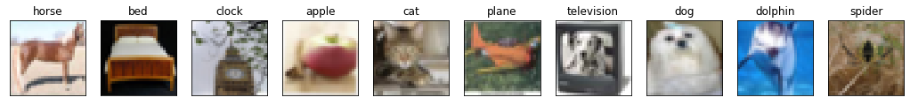

Framework of ML —— Mismatch
Your training and testing data have different distributions.
Be aware of how data is generated.
Training Data
Simply increasing the training data will not help.
Testing Data

Slide 48
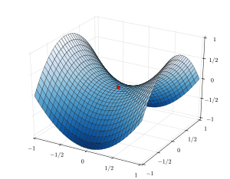
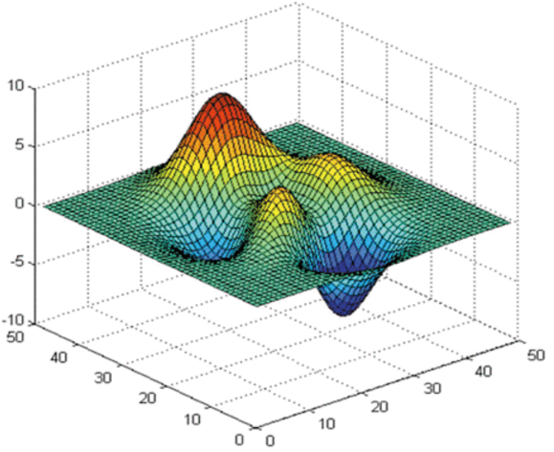
Small Gradient
Optimization Fails because ……
local minima
saddle point
No way to go
escape
training
loss
Which one?
gradient is close to zero
critical point
Not small enough
updates

Slide 49
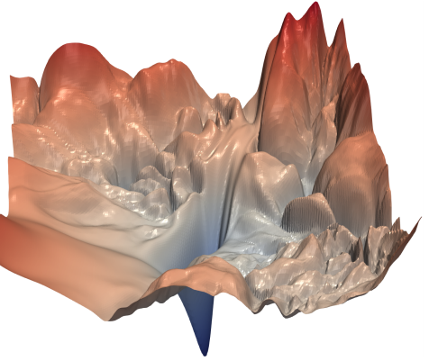
Small Gradient
Saddle Point v.s. Local Minima
Saddle point in higher dimension?
When you have lots of parameters, perhaps local minima is rare?

Slide 50



Small Gradient
Loss
Gradient Descent
Very slow at the plateau
Stuck at saddle point
Stuck at local minima
$$∂L∕∂w$$
$$≈0$$
$$∂L∕∂w$$
$$=0$$
$$∂L∕∂w$$
$$=0$$
The value of a network parameter w

Slide 51
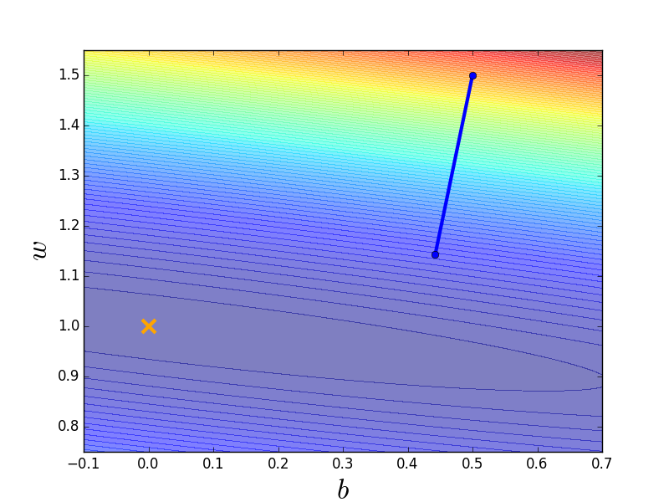
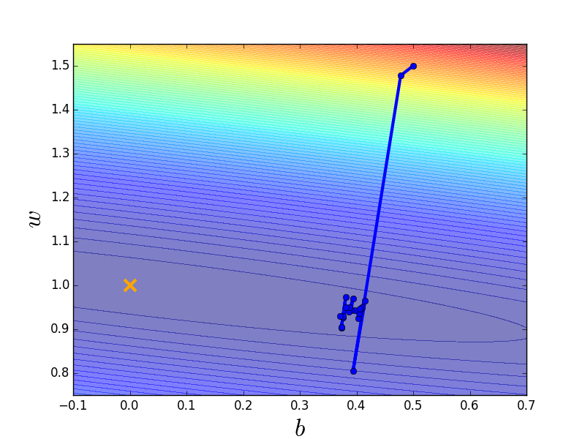
Small Gradient —— Tips1: Batch
Small Batch v.s. Large Batch
Consider 20 examples (N=20)
Batch size = N (Full batch)
Batch size = 1
Update after seeing all the 20 examples
Update for each example
Update 20 times in an epoch
See all examples
See only one example
See all examples
Long time for cooldown, but powerful
Short time for cooldown, but noisy

Slide 52

Small Gradient —— Tips1: Batch
Small Batch v.s. Large Batch
 | Small | Large
Speed for one update (no parallel) | Faster | Slower
Speed for one update (with parallel) | Same | Same (not too large)
Time for one epoch | Slower | Faster
Gradient | Noisy | Stable
Optimization | Better | Worse
Generalization | Better | Worse
Batch size is a hyperparameter you have to decide.

Slide 53
Small Gradient —— Tips2: Momentum
Loss
Consider the physical world …
How about put this phenomenon in gradient descent?
The value of a network parameter w

Slide 54
Small Gradient —— Tips2: Momentum
Gradient Descent + Momentum
loss
Movement =
Negative of 𝜕𝐿∕𝜕𝑤 + Last Movement
Negative of $∂L∕∂w$
Last Movement
Real Movement
𝜕𝐿∕𝜕𝑤 = 0

Slide 55
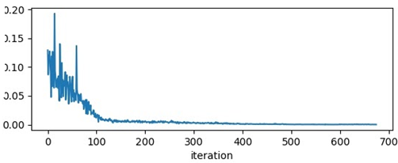
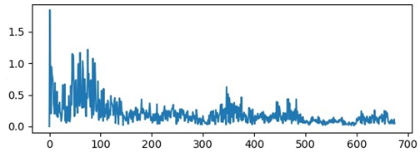
Optimizer
Error surface is rugged: Adaptive Learning Rate
People believe training stuck because the parameters are around a critical point …
loss
norm of gradient

Slide 56
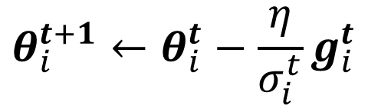
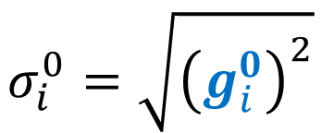
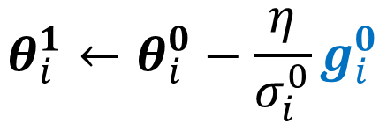

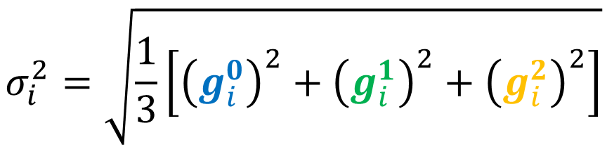
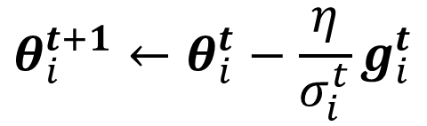
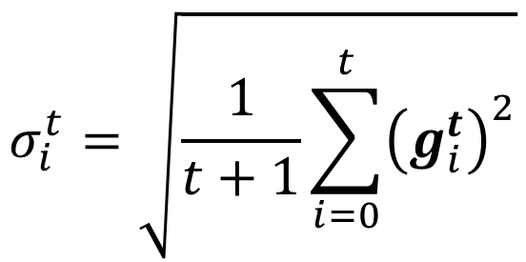
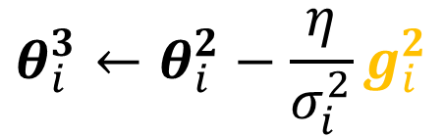
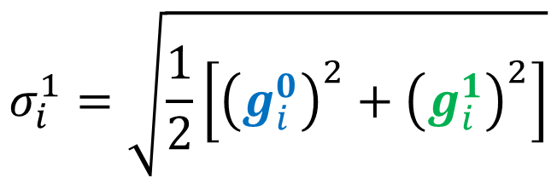
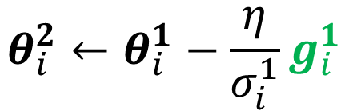
Optimizer —— RMS
Root Mean Square
$$θ_{i}^{t+1}←θ_{i}^{t}−\frac{\text{η}}{σ_{i}^{t}}g_{i}^{t}$$
$$θ_{i}^{1}←θ_{i}^{0}−\frac{\text{η}}{σ_{i}^{0}}g_{i}^{0}$$
$$σ_{i}^{0}=\sqrt{{\left(g_{i}^{0}\right)}^{2}}$$
$$=\left|g_{i}^{0}\right|$$
$$σ_{i}^{1}=\sqrt{\frac{1}{2}\left[{\left(g_{i}^{0}\right)}^{2}+{\left(g_{i}^{1}\right)}^{2}\right]}$$
$$θ_{i}^{2}←θ_{i}^{1}−\frac{\text{η}}{σ_{i}^{1}}g_{i}^{1}$$
$$σ_{i}^{2}=\sqrt{\frac{1}{3}\left[{\left(g_{i}^{0}\right)}^{2}+{\left(g_{i}^{1}\right)}^{2}+{\left(g_{i}^{2}\right)}^{2}\right]}$$
$$θ_{i}^{3}←θ_{i}^{2}−\frac{\text{η}}{σ_{i}^{2}}g_{i}^{2}$$
……
$$σ_{i}^{t}=\sqrt{\frac{1}{t+1}\sum_{i=0}^{t}{{\left(g_{i}^{t}\right)}^{2}}}$$
$$θ_{i}^{t+1}←θ_{i}^{t}−\frac{\text{η}}{σ_{i}^{t}}g_{i}^{t}$$

Slide 57
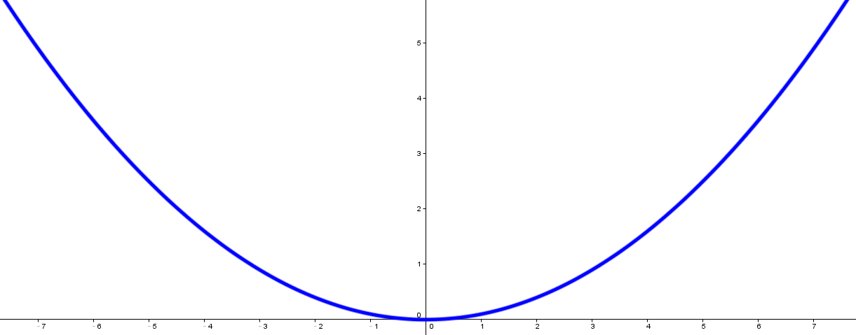
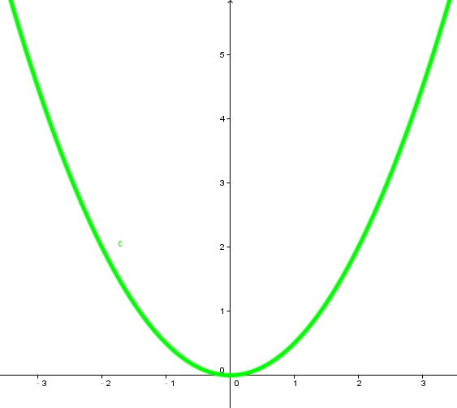


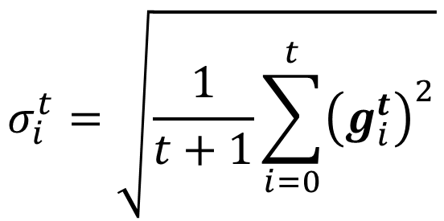




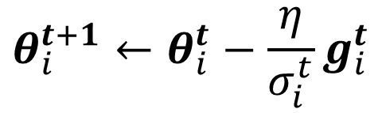


Optimizer —— RMS
smaller
$$σ_{1}^{t}$$
$$g_{1}^{t−1}$$
larger step
$$g_{1}^{t}$$
$$θ_{i}^{t+1}←θ_{i}^{t}−\frac{\text{η}}{σ_{i}^{t}}g_{i}^{t}$$
$$θ_{1}$$
$$σ_{i}^{t}=\sqrt{\frac{1}{t+1}\sum_{i=0}^{t}{{\left(g_{i}^{t}\right)}^{2}}}$$
$$g_{2}^{t−1}$$
larger
$$σ_{2}^{t}$$
smaller step
$$g_{2}^{t}$$
Used in Adagrad
$$θ_{2}$$

Slide 58
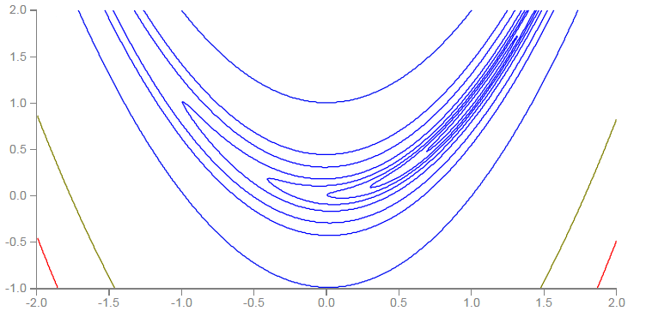


Optimizer
Learning rate adapts dynamically
Error Surface can be very complex.
Smaller Learning Rate
$$w_{2}$$
Larger Learning Rate
$$w_{1}$$

Slide 59
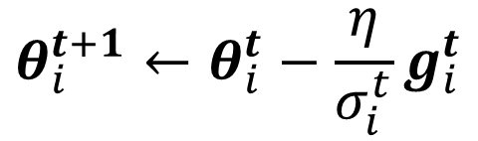
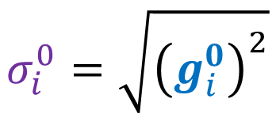







Optimizer —— RMSProp
$$θ_{i}^{t+1}←θ_{i}^{t}−\frac{\text{η}}{σ_{i}^{t}}g_{i}^{t}$$
$$θ_{i}^{1}←θ_{i}^{0}−\frac{\text{η}}{σ_{i}^{0}}g_{i}^{0}$$
$$σ_{i}^{0}=\sqrt{{\left(g_{i}^{0}\right)}^{2}}$$
$$0<α<1$$
$$θ_{i}^{2}←θ_{i}^{1}−\frac{\text{η}}{σ_{i}^{1}}g_{i}^{1}$$
$$σ_{i}^{1}=\sqrt{{α\left(σ_{i}^{0}\right)}^{2}+\left(1−α\right){\left(g_{i}^{1}\right)}^{2}}$$
$$θ_{i}^{3}←θ_{i}^{2}−\frac{\text{η}}{σ_{i}^{2}}g_{i}^{2}$$
$$σ_{i}^{2}=\sqrt{{α\left(σ_{i}^{1}\right)}^{2}+\left(1−α\right){\left(g_{i}^{2}\right)}^{2}}$$
……
$$θ_{i}^{t+1}←θ_{i}^{t}−\frac{\text{η}}{σ_{i}^{t}}g_{i}^{t}$$
$$σ_{i}^{t}=\sqrt{{α\left(σ_{i}^{t−1}\right)}^{2}+\left(1−α\right){\left(g_{i}^{t}\right)}^{2}}$$

Slide 60









Optimizer —— RMSProp
$$g_{i}^{1}$$
$$g_{i}^{2}$$
……
$$g_{i}^{t−1}$$
$$0<α<1$$
$$θ_{i}^{t+1}←θ_{i}^{t}−\frac{\text{η}}{σ_{i}^{t}}g_{i}^{t}$$
$$σ_{i}^{t}=\sqrt{{α\left(σ_{i}^{t−1}\right)}^{2}+\left(1−α\right){\left(g_{i}^{t}\right)}^{2}}$$
The recent gradient has larger influence, and the past gradients have less influence.
small $σ_{i}^{t}$
increase $σ_{i}^{t}$
larger step
smaller step
decrease $σ_{i}^{t}$
larger step

Slide 61

Optimizer —— Adam
Adam: RMSProp + Momentum
Original paper: https://arxiv.org/pdf/1412.6980.pdf
for momentum
for RMSprop

Slide 62


Optimizer —— Summary
(Vanilla) Gradient Descent
$$θ_{i}^{t+1}←θ_{i}^{t}−\text{η}g_{i}^{t}$$
Various Improvements
Learning rate scheduling
$$θ_{i}^{t+1}←θ_{i}^{t}−\frac{η^{t}}{σ_{i}^{t}}m_{i}^{t}$$
Momentum: weighted sum of the previous gradients
Consider direction
root mean square of the gradients
only magnitude

Slide 63













Normalization
Changing Landscape
Loss L
Loss L
steep
smooth
large
$$+∆y$$
$$w_{1}$$
$$\hat{y}$$
$$y$$
$$x_{1}$$
1, 2 ……
$$e$$
$$+∆e$$
small
same
range
large
$$b$$
$$L=\sum{e}$$
$$w_{2}$$
1
$$+∆w_{2}$$
$$x_{2}$$
100, 200 ……
$$+∆L$$
large
large

Slide 64













Normalization
Feature Normalization
$$x^{1}$$
$$x^{2}$$
$$x^{3}$$
$$x^{r}$$
$$x^{R}$$
For each dimension $i$:
$$x_{1}^{1}$$
$$x_{1}^{2}$$
$$x_{2}^{1}$$
$$x_{2}^{2}$$
……
……
mean: $m_{i}$
……
……
……
……
……
standard deviation: $σ_{i}$
$${\tilde{x}}_{i}^{r}←\frac{x_{i}^{r}−m_{i}}{σ_{i}}$$
The means of all dims are 0, and the variances are all 1
In general, feature normalization makes gradient descent converge faster.

Slide 65















Normalization
Considering Deep Learning
Different dims have different ranges.
$$W^{1}$$
$$z^{1}$$
Sigmoid
$$a^{1}$$
$$W^{2}$$
……
$${\tilde{x}}^{1}$$
$$W^{1}$$
$$z^{2}$$
Sigmoid
$$a^{2}$$
$$W^{2}$$
$${\tilde{x}}^{2}$$
……
$$W^{1}$$
$$z^{3}$$
Sigmoid
$$a^{3}$$
$$W^{2}$$
$${\tilde{x}}^{3}$$
……
Also difficult to optimize
Feature Normalization
Also need normalization

Slide 66

Normalization
Batch normalization
Original paper: https://arxiv.org/abs/1502.03167
Experimental results (and theoretically analysis) support batch normalization change the landscape of error surface.

Slide 67
Thanks

